Slide 1
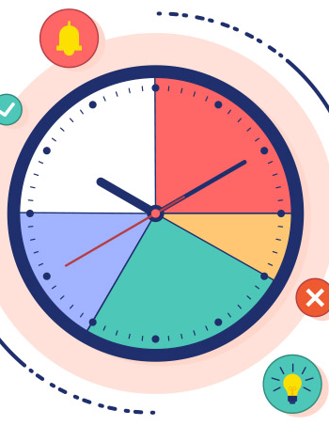

Project time

Slide 2
Project 1 : Simple Calculator
Description: Build a program that takes two numbers and an operator (+, -, *, /) as input and displays the result. The program should handle invalid inputs (e.g., non-numeric values, division by zero).
Steps to Start:
Use prompt-sync to get two numbers and an operator.
Create a function to perform the calculation based on the operator.
Validate inputs (ensure numbers are valid, operator is one of +, -, *, /).
Handle division by zero with an error message.
Display the result.

Slide 3
Project 1 : Simple Calculator
Sample Input/Output:
Input: 5, +, 3 → Output: Result: 8
Input: 10, /, 0 → Output: Cannot divide by zero
Edge Cases: Non-numeric inputs, invalid operators, division by zero.
Tips: Use isNaN() to check for valid numbers, and a switch or if-else for operator logic.

Slide 4
Project 2 : Guess the number
Description: The program generates a random number (1–100). The user guesses it, and the program provides hints (too high/too low) until the correct number is guessed or the user quits.
Steps to Start:
Generate a random number using Math.floor(Math.random() * 100) + 1.
Use a while loop to repeatedly prompt for guesses.
Compare the guess to the target number and print hints.
Allow the user to quit (e.g., input q).
Count attempts and display when correct.

Slide 5
Project 2 : Guess the number
Sample Input/Output:
Input: 50 → Output: Too high! Try again.
Input: 25 → Output: Correct! Took 2 attempts.
Edge Cases: Non-numeric guesses, negative numbers, quitting early.
Tips: Use parseInt() for input validation, and add a quit option.

Slide 6
Project 3 : To-do list manager
Description: A menu-driven program to add, view, remove tasks stored in an array, and exit. Tasks are simple strings.
Steps to Start:
Create an empty array for tasks.
Use a while loop to show a menu (1: Add, 2: View, 3: Remove, 4: Exit).
Add tasks with push, remove with splice, view with forEach.
Validate removal index.
Display tasks with 1-based indices

Slide 7
Project 3 : To-do list manager
Sample Input/Output:
Input: 1, Buy groceries → Output: Task added.
Input: 2 → Output: 1. Buy groceries
Edge Cases: Empty task list, invalid indices, invalid menu options.
Tips: Use parseInt() for index input; check array bounds.

Slide 8
Project 4 : Rock, Paper, Scissors
Description: A game where the user inputs rock, paper, or scissors, and the computer randomly chooses. Determine the winner based on rules (rock > scissors, scissors > paper, paper > rock).
Steps to Start:
Define an array ['rock', 'paper', 'scissors'].
Prompt for user choice and validate.
Generate computer choice with Math.random().
Use conditionals to determine the winner.
Loop to allow replay or quitting.

Slide 9
Project 4 : Rock, Paper, Scissors
Sample Input/Output:
Input: rock → Output: Computer: scissors, You win!
Input: paper → Output: Computer: paper, Tie!
Edge Cases: Invalid inputs (e.g., stone), case sensitivity.
Tips: Use toLowerCase() for input; modularize winner logic.

Slide 10
Project 5 : Multiple Table Generator
Description: Take a number and print its multiplication table (1 to 10).
Steps to Start:
Prompt for a number.
Validate it’s a number with isNaN.
Use a for loop to print num * i for i from 1 to 10.
Format output (e.g., 5 x 1 = 5).

Slide 11
Project 5 : Multiple Table Generator
Sample Input/Output:
Input: 5 → Output: 5 x 1 = 5, ..., 5 x 10 = 50
Input: abc → Output: Invalid number
Edge Cases: Non-numeric inputs, negative numbers.
Tips: Keep output aligned with template literals.

Slide 12
Project 6 : Fibonacci Sequence Printer
Description: Print the Fibonacci sequence for a user-specified number of terms (e.g., 0, 1, 1, 2, 3 for 5 terms).
Steps to Start:
Prompt for number of terms.
Validate input (positive integer).
Initialize array with [0, 1].
Use a loop to generate Fibonacci numbers.
Print the sequence

Slide 13
Project 6 : Fibonacci Sequence Printer
Sample Input/Output:
Input: 6 → Output: 0, 1, 1, 2, 3, 5
Input: 0 → Output: Invalid number of terms
Edge Cases: Non-positive inputs, non-numeric inputs.
Tips: Handle cases for 1 or 2 terms separately.

Slide 14
Project 7 : Simple Quiz Game
Description: Ask 5 multiple-choice questions stored in an array of objects. Take user answers (a, b, c) and show the final score.
Steps to Start:
Define an array of objects with question, options, and correct answer.
Loop through questions, displaying each with options.
Prompt for answer and validate (a, b, c).
Track score and display at the end.

Slide 15
Project 7 : Simple Quiz Game
Sample Input/Output:
Input: b for “What is 2+2? a) 3 b) 4 c) 5” → Output: Correct!
Final: Score: 4/5
Edge Cases: Invalid answers, case sensitivity.
Tips: Use toLowerCase() for answers; store questions as objects.

Slide 16
Project 8 : Palindrome Checker
Description: Check if a user-entered string is a palindrome (same forward and backward, ignoring case and non-alphanumeric characters).
Steps to Start:
Prompt for a string.
Clean input (lowercase, remove non-alphanumeric with regex).
Reverse the string and compare.
Output result.

Slide 17
Project 8 : Palindrome Checker
Sample Input/Output:
Input: Racecar → Output: It's a palindrome!
Input: hello → Output: Not a palindrome
Edge Cases: Empty strings, spaces, punctuation.

Slide 18
Project 9 : Array Sorter
Description: Take a comma-separated list of numbers, store in an array, and sort in ascending or descending order based on user choice.
Steps to Start:
Prompt for numbers (e.g., 5,2,8).
Split input and convert to numbers.
Prompt for sort order (asc/desc).
Use sort() with a comparison function.
Output sorted array.

Slide 19
Project 9 : Array Sorter
Sample Input/Output:
Input: 5,2,8, asc → Output: 2,5,8
Input: 5,2,8, desc → Output: 8,5,2
Edge Cases: Invalid numbers, empty input, invalid order.
Tips: Use map(Number) and isNaN for validation.

Slide 20
Project 10 : Basic Budget Tracker
Description: Track income and expenses in an array, calculate balance, and view transaction history.
Steps to Start:
Initialize an array for transactions (objects with type, amount, description).
Create a menu loop (1: Add Income, 2: Add Expense, 3: View Balance, 4: View History, 5: Exit).
Update balance based on transaction type.
Validate amounts (positive numbers).
Display transactions and balance.

Slide 21
Project 10 : Basic Budget Tracker
Sample Input/Output:
Input: 1, 100, Salary → Output: Income added.
Input: 3 → Output: Balance: 100
Edge Cases: Negative amounts, empty descriptions, invalid options.
Tips: Store transactions as objects for clarity.

Slide 22
Inventory Management System
Description: Manage a store’s inventory (items with name, quantity, price) in an array. Support adding, updating, deleting, and low-stock alerts (quantity < 5).
Steps to Start:
Initialize an array for items (objects with name, quantity, price).
Create a menu loop (1: Add, 2: Update, 3: Delete, 4: View Inventory, 5: Exit).
Validate inputs (unique names, positive quantity/price).
Flag low stock when viewing.
Display items with indices.

Slide 23
Inventory Management System
Sample Input/Output:
Input: 1, Apple, 10, 1.5 → Output: Item added.
Input: 4 → Output: 1. Apple, 10, $1.5
Edge Cases: Duplicate names, negative quantities/prices, empty inventory.
Tips: Use find to check for duplicates; format output clearly.

Slide 24
Anagram Checker
Description: Check if two strings are anagrams by comparing sorted characters.
Steps to Start:
Prompt for two strings.
Clean strings (lowercase, remove non-alphanumeric).
Sort characters and compare.
Output result.

Slide 25
Anagram Checker
Sample Input/Output:
Input: listen, silent → Output: Anagrams!
Input: hello, world → Output: Not anagrams
Edge Cases: Empty strings, spaces, punctuation.
Tips: Use split, sort, join for comparison.

Slide 26
Word Frequency Counter
Description: Count the frequency of each word in a sentence, storing results in an object.
Steps to Start:
Prompt for a sentence.
Clean input (lowercase, remove punctuation, split into words).
Use an object to tally word occurrences.
Display the frequency object.

Slide 27
Word Frequency Counter
Sample Input/Output:
Input: The cat the dog → Output: { the: 2, cat: 1, dog: 1 }
Input: `` → Output: Empty input
Edge Cases: Empty strings, multiple spaces, punctuation.

Slide 28
Contact Book
Description: Store contacts (name, phone, email) in an array of objects. Support adding, searching, updating, and deleting contacts.
Steps to Start:
Initialize an empty array for contacts.
Create a menu loop (1: Add, 2: Search, 3: Update, 4: Delete, 5: Exit).
Add contacts with push; search/update/delete by name.
Validate phone (xxx-xxx-xxxx) and email (basic format).
Display contact details.

Slide 29
Contact Book
Sample Input/Output:
Input: 1, John, 123-456-7890, john@email.com → Output: Contact added.
Input: 2, John → Output: John, 123-456-7890, john@email.com
Edge Cases: Duplicate names, invalid formats, empty list.

Slide 30
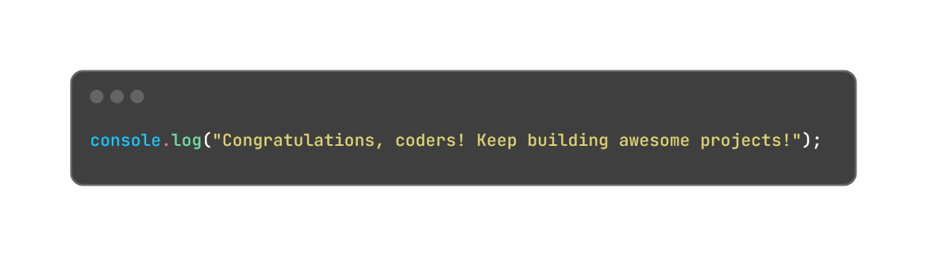
Conclusion

